Slide 1
ANALYSIS OF SINGAPORE resident HDB population and HDB resale TRANSACTIONS
SHERRY TAN / NSDAI

Slide 2
overview
Resale flat transactions in 2015 – 2018
Resident population in HDB flats
Age group distribution in HDB flats
Further Exploration

Slide 3
Data sets
1. Singapore Resident Population in HDB Flats 2008 - 2016
https://data.gov.sg/dataset/estimated-resident-population-living-in-hdb-flats
2. Resale flat transactions 2015 – 2018
https://data.gov.sg/dataset/resale-flat-prices
3. Age group distribution in HDB Flats 2008 - 2013
https://data.gov.sg/dataset/age-of-hdb-population-by-ethnic-group-and-flat-type-in-age-groups

Slide 4
HDB resale flat prices

Slide 5
ABOUT THE DATA SET
Data set gives resale prices and information about the HDB flat sold
4 data sets are available at the URL, spanning different date ranges. For the purpose of this analysis, the data set for Jan 2015 – Feb 2018 was used
For the selected data set
59809 resale transactions
11 variables include: month, town, flat_type, block, street_name, storey_range, floor_area_sqm, flat_model, lease_commence_date, remaining_lease, resale_price
Resale transactions covered 26 towns
resale FLAT TRANSACTIONS

Slide 6
ABOUT THE DATA SET
Median resale price was $ 410,000
Highest resale price was $1,180,000 for a flat in Bishan, sold in 2017-02
Flat-type: 5 room
Floor number: 40 to 42
Floor area: 120 sqm
Remaining Lease: 93 years
Number of resale transactions by flat-type:
1 ROOM: 25
2 ROOM: 598
3 ROOM: 15611
4 ROOM: 24628
5 ROOM: 14257
EXECUTIVE: 4681
MULTI-GENERATION: 9
resale FLAT TRANSACTIONS

Slide 7
PROCESS
Data was loaded into numpy array using np.genfromtext selectively. Some columns such as ‘block’ and ‘street_name’ were omitted as there would be too many different data values for the purpose of this analysis
Histogram was used to show the distribution of resale prices
plt.hist to plot histograms with plt.text and bbox specifications to annotate number of transactions
Boxplots to compare resale price distributions for different flat types
plt.boxplot to plot boxplots, defining properties for median, box, cap, whisker and flier to refine aesthetics
Distribution could be expected to vary between towns. To dive deeper in the data, histograms and boxplots could be generated for a user-specified town (available as separate jupyter notebook)
For this presentation, the overall distribution will be shown
resale FLAT TRANSACTIONS
Notes:
Floor area – space impt consideration in purchasing a flat.
Lease – median lease remaining gives user idea of whether his flat would be attractive in current resale market

Slide 8
PROCESS
Besides resale price, some variables of interest are floor area and remaining lease
Scatterplot to visualize relationship between resale price and floor area / remaining lease
plt.scatter to create scatterplots with ‘resale_price’ and ‘floor_area_sqm’ as primary variables on the y- and x- axis
cmap and color attributes in plt.scatter are defined to vary the color intensity of markers according to the 3rd variable, ‘remaining_lease’
Functions from matplotlib.colors and matplotlib.cm were used to create a colorbar
Scatterplot showing all 59000+ records will be noisy. The relationship of the 3 variables could also be expected to vary for different towns and flat types. Scatterplots could be generated based on user-specified input (available as separate jupyter notebook)
resale FLAT TRANSACTIONS
Notes:
import matplotlib.cm as cm import matplotlib.colors as mcolors
normalize = mcolors.Normalize(vmin=np.min(lease), vmax=np.max(lease)) for l in lease: plt.plot(color=colormap(normalize(l))) scalarmappaple = cm.ScalarMappable(norm=normalize, cmap=colormap) scalarmappaple.set_array(lease) cbar = plt.colorbar(scalarmappaple) cbar.ax.set_ylabel('Lease remaining (years)')

Slide 9
PROCESS
Scatterplots can also be used to compare:
highest resale price transactions among towns
median values for resale price, floor area and remaining lease on a single chart
To facilitate analysis, new table was created to aggregate data of interest for each town
resale FLAT TRANSACTIONS
Notes:
import matplotlib.cm as cm import matplotlib.colors as mcolors
normalize = mcolors.Normalize(vmin=np.min(lease), vmax=np.max(lease)) for l in lease: plt.plot(color=colormap(normalize(l))) scalarmappaple = cm.ScalarMappable(norm=normalize, cmap=colormap) scalarmappaple.set_array(lease) cbar = plt.colorbar(scalarmappaple) cbar.ax.set_ylabel('Lease remaining (years)')

Slide 10
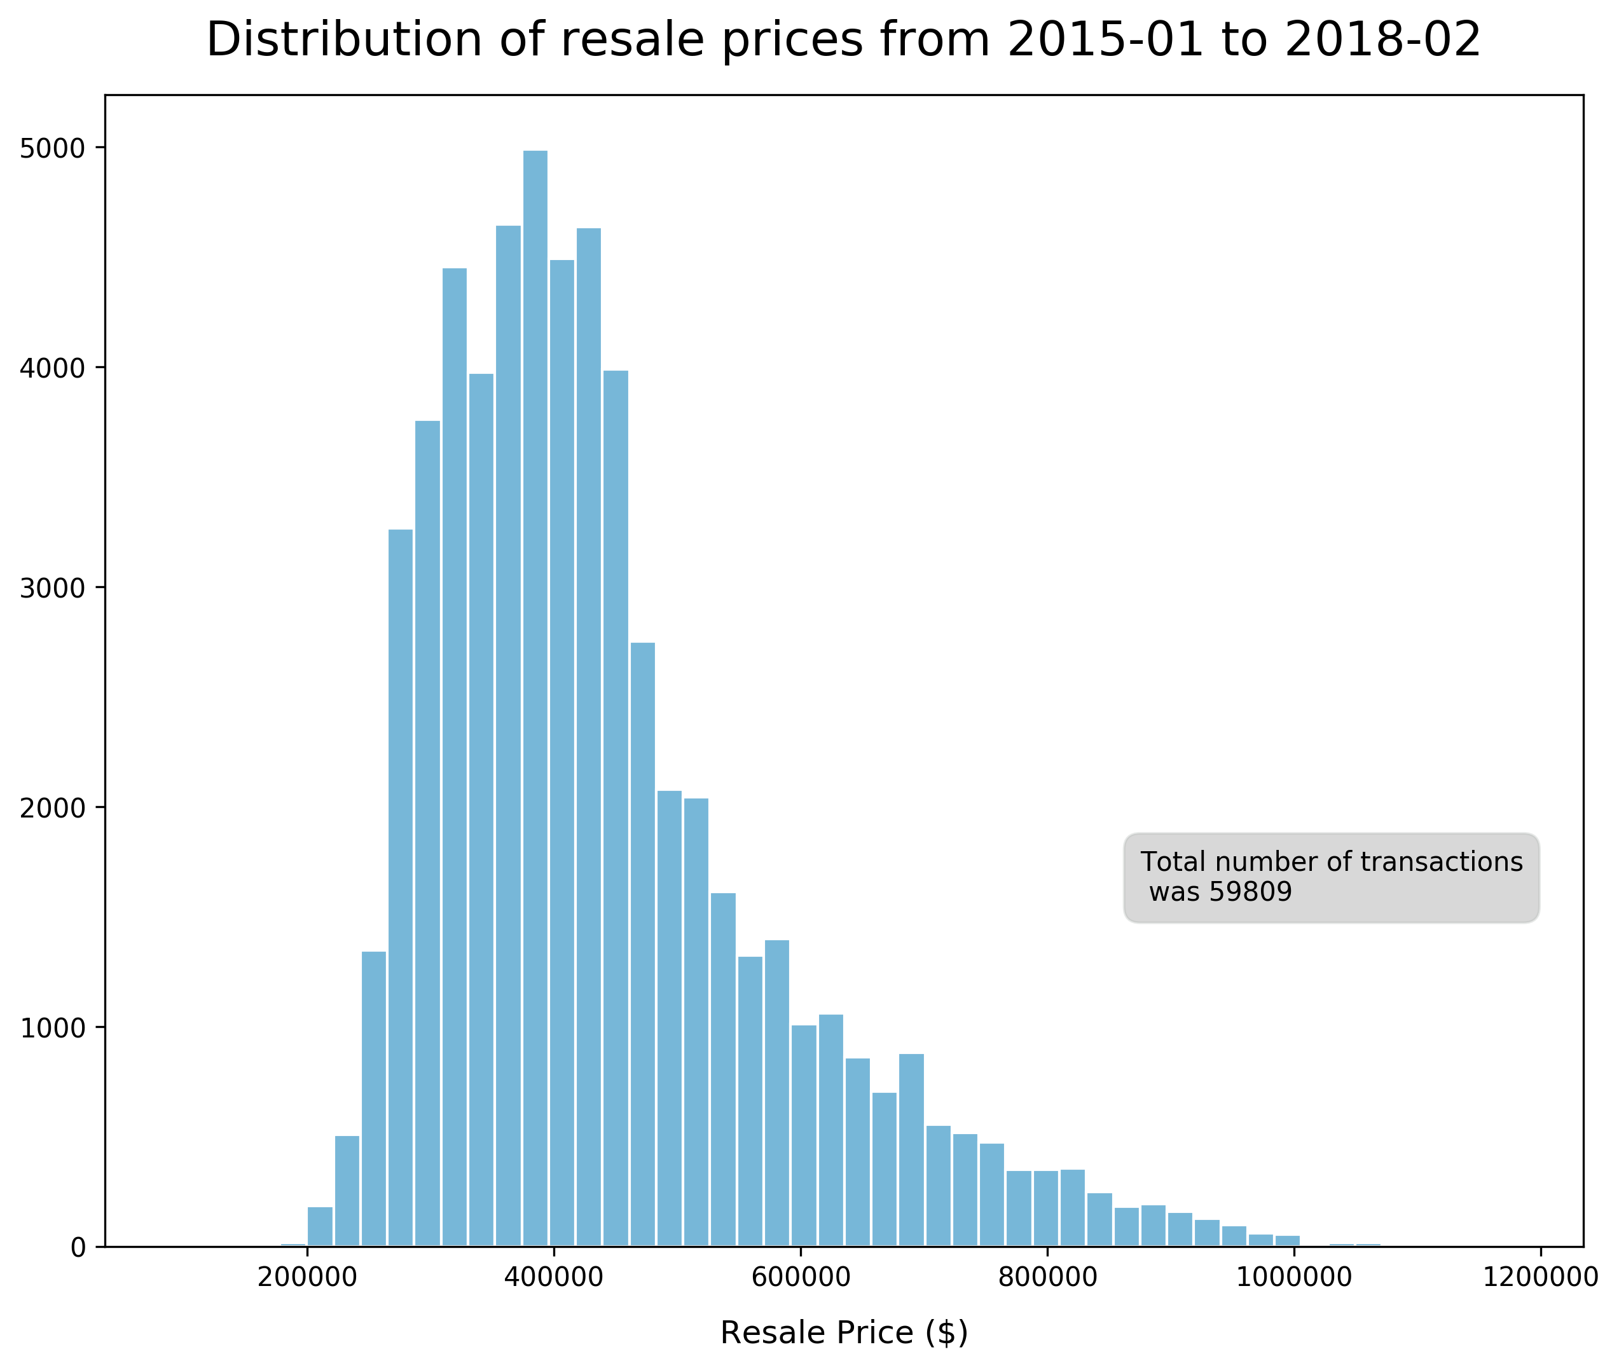
Resale price distribution is right skewed with a maximum price of $1,180,000 and a median price of $410,000
resale FLAT TRANSACTIONS
Notes:
Resale transaction prices generally showed a right-skewed distribution
Highest resale price was $1180000.00 for a flat in Bishan, sold in 2017-02 - Flat-type: 5 room - Floor number: 40 to 42 - Floor area: 120.0 square metres - Remaining Lease: 93.0 years Median price was $410000.00 Lowest resale price was $90500.00 for a flat in Woodlands, sold in 2018-01 - Flat-type: 3 room - Floor number: 01 to 03 - Floor area: 60.0 square metres - Remaining Lease: 66.0 years

Slide 11
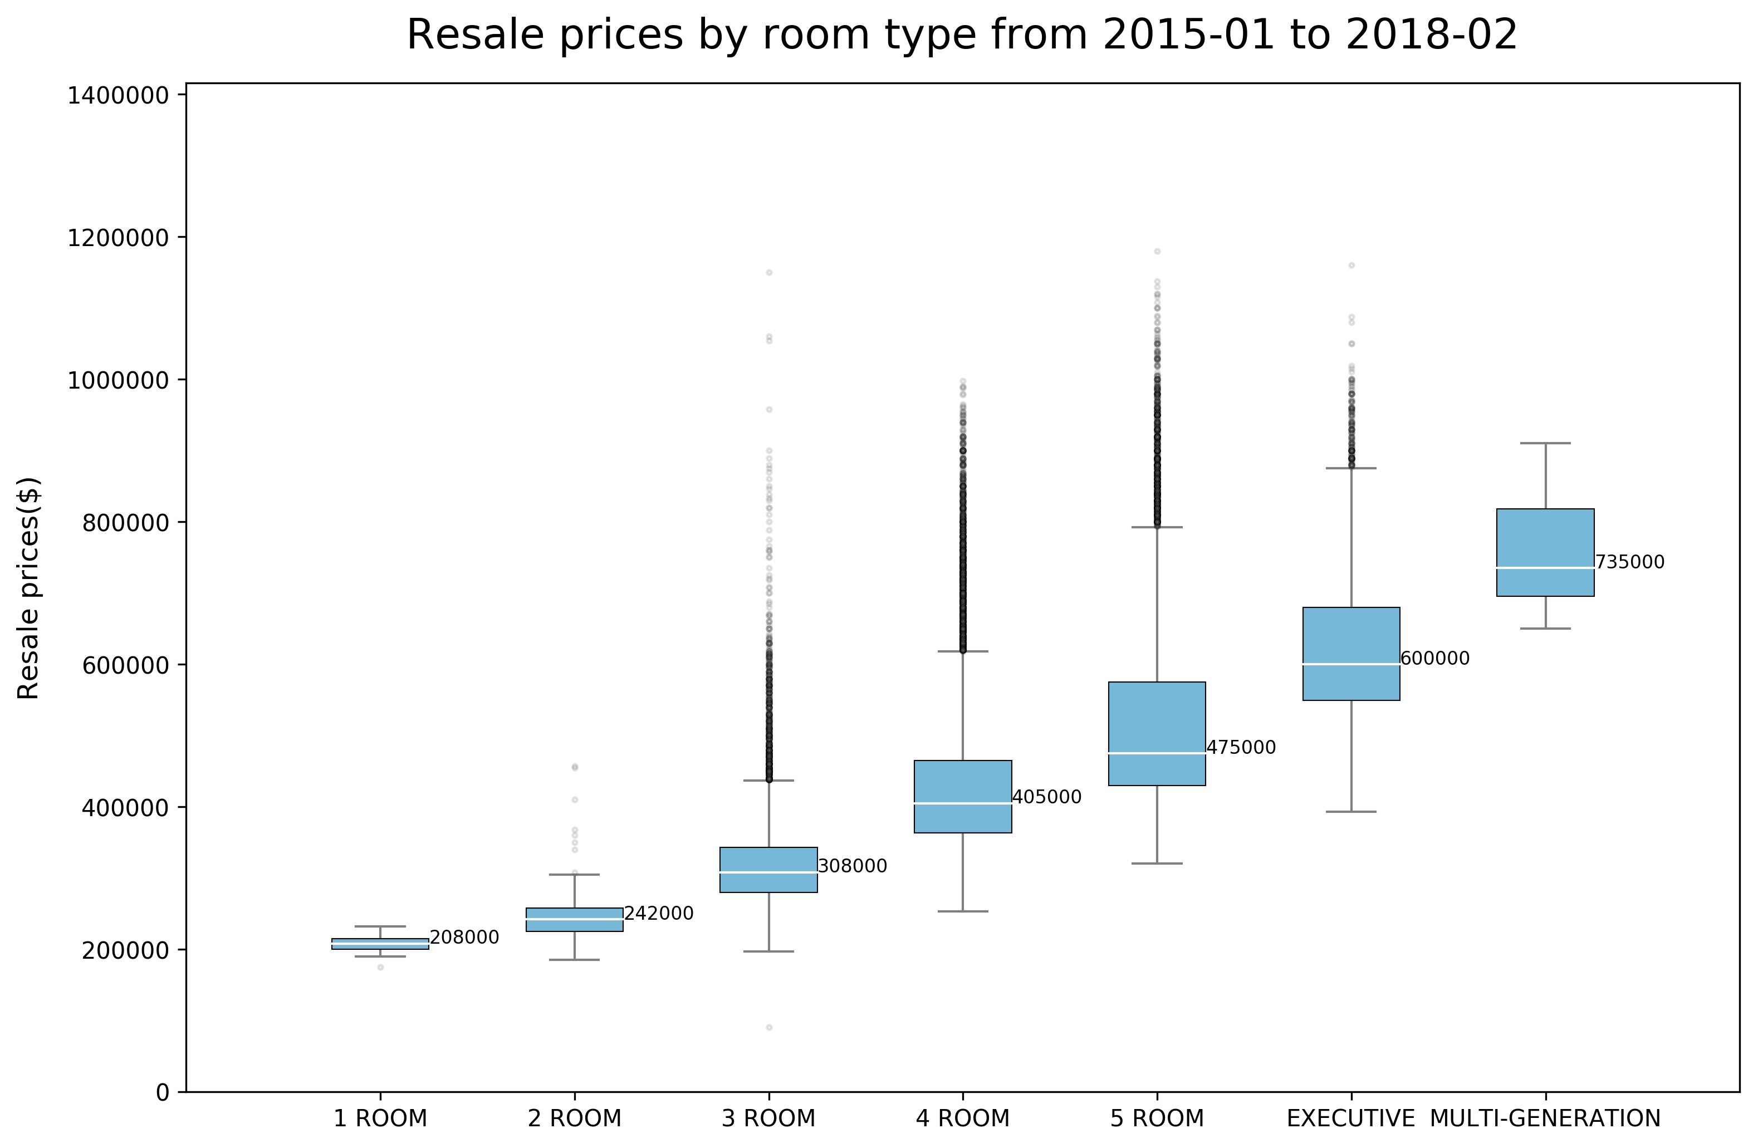
91% of resale transactions are in these categories
resale FLAT TRANSACTIONS
Notes:
Most of the resale transactions in the period were for 3-room to 5-room flats. Naturally, the larger volume of transactions gave a wider spread of resale prices for these flat types. There were many outliers for these flat types above the 75th percentile
There is some degree of overlap in prices for 4-room, 5 – room and Executive flats, where prices at the 75th percentile were comparable to the medians of the next flat type

Slide 12
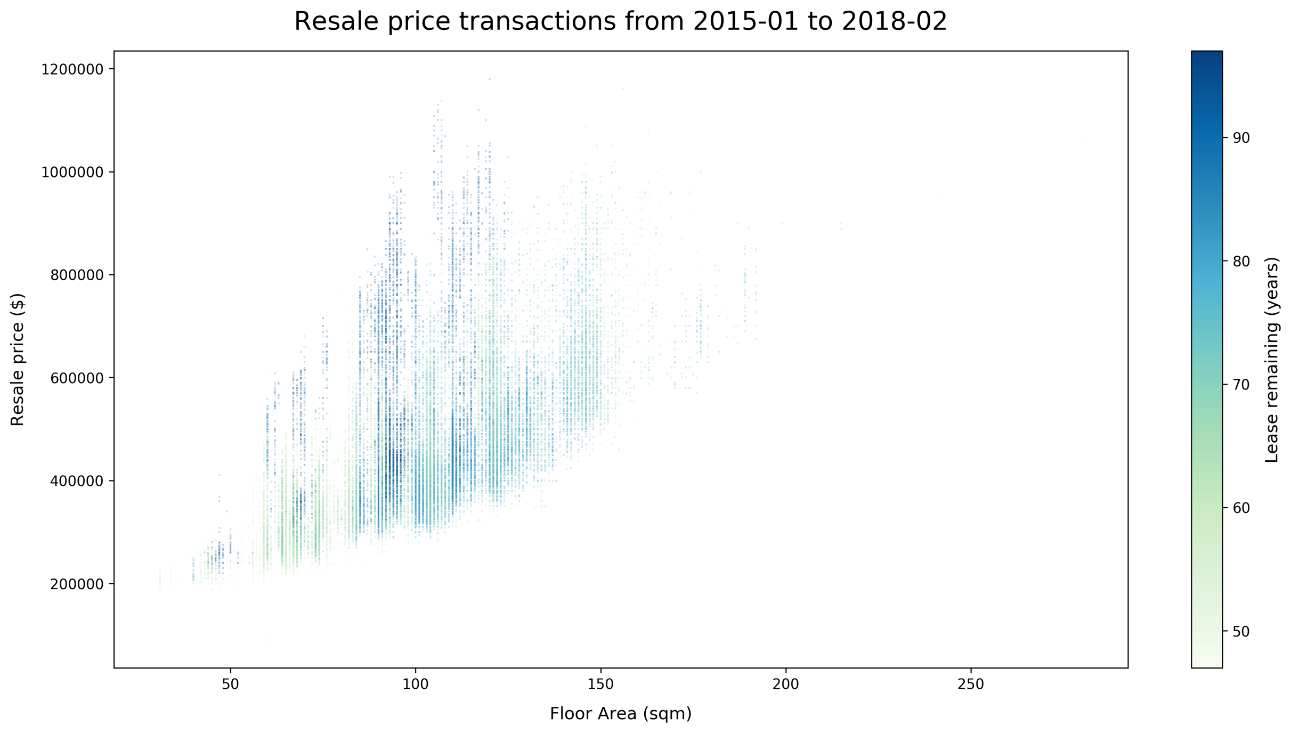
Generally a positive correlation but..
resale FLAT TRANSACTIONS

Slide 13
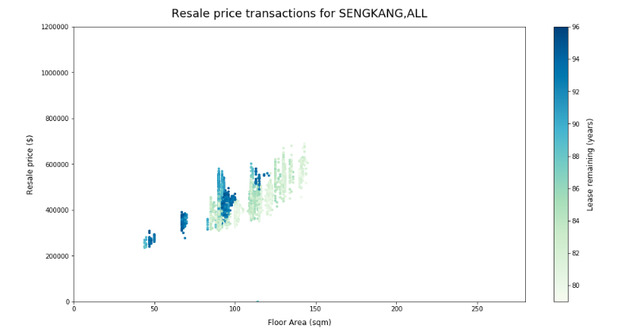
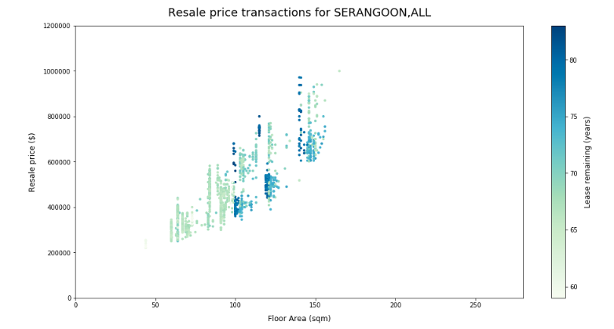
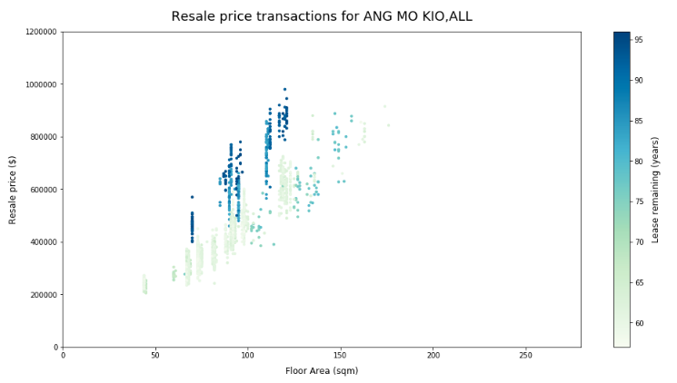
Trends in individual towns can be quite different!

Slide 14
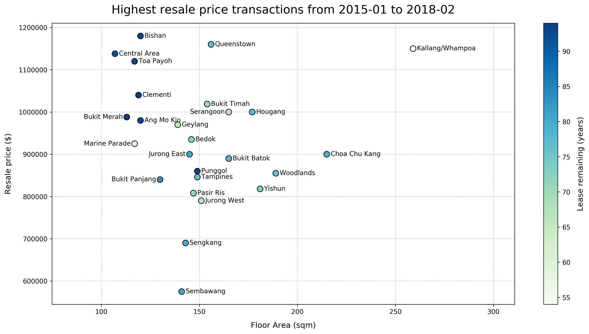
Most transactions clustered in the top left. Among highest resale transactions, there is variability in lease remaining
resale FLAT TRANSACTIONS
Notes:
The highest resale transactions for each town share similar attributes with resale prices ranging from $800,000 to $1,200,000 and floor area between 100-200sqm, with those with remaining lease at the upper end clustering around the top range of prices. There is little correlation between price and lease below 95 years
Anomalies are Kallang/Whampoa and CCK (much larger than the rest) and Sengkang and Sembawang (much cheaper than the rest)
The mature estates tend to have higher resale prices

Slide 15
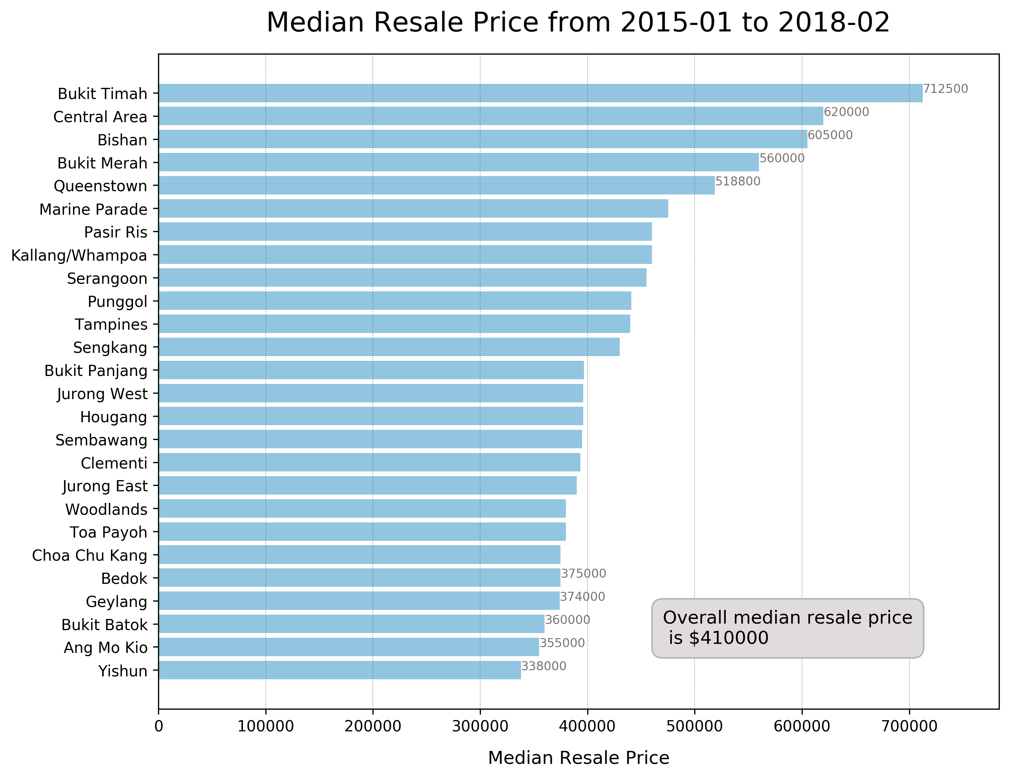
Sengkang and Sembawang have median resale prices comparable to the overall median although their highest resale prices are much lower compared to other towns
resale FLAT TRANSACTIONS
Notes:
Expected Sengkang and Sembawang to also reflect lower median prices….but this was not the case! Less variance than in other towns…or few outliers compared to other towns?

Slide 16
Town | Highest Resale Price | Transaction Date | Flat Type | Floor Number | Floor Area | Remaining Lease
Ang Mo Kio | 980000 | 2016-09 | 5 room | 28 to 30 | 120 | 93
Bedok | 935000 | 2016-02 | executive | 07 to 09 | 146 | 72
Bishan | 1180000 | 2017-02 | 5 room | 40 to 42 | 120 | 93
Bukit Batok | 890000 | 2018-01 | executive | 16 to 18 | 165 | 78
Bukit Merah | 988000 | 2017-09 | 5 room | 40 to 42 | 113 | 94
Bukit Panjang | 840000 | 2017-07 | executive | 19 to 21 | 130 | 83
Bukit Timah | 1018888 | 2017-09 | executive | 07 to 09 | 154 | 70
Central Area | 1138000 | 2017-11 | 5 room | 43 to 45 | 107 | 92
Choa Chu Kang | 900000 | 2018-01 | executive | 10 to 12 | 215 | 79
Clementi | 1040000 | 2017-04 | 5 room | 37 to 39 | 119 | 94
Geylang | 970000 | 2017-08 | 5 room | 04 to 06 | 139 | 66
Hougang | 1000000 | 2018-01 | executive | 13 to 15 | 177 | 78
Jurong East | 900000 | 2017-06 | executive | 13 to 15 | 145 | 80
Jurong West | 790000 | 2017-04 | executive | 04 to 06 | 151 | 67
Kallang/Whampoa | 1150000 | 2016-12 | 3 room | 01 to 03 | 259 | 54
Marine Parade | 925000 | 2017-07 | 5 room | 19 to 21 | 117 | 58
Pasir Ris | 808000 | 2018-02 | executive | 10 to 12 | 147 | 71
Punggol | 860000 | 2017-10 | 5 room | 16 to 18 | 149 | 94
Queenstown | 1160000 | 2017-07 | executive | 19 to 21 | 156 | 77
Sembawang | 575000 | 2016-11 | executive | 10 to 12 | 141 | 80
Sengkang | 690000 | 2017-11 | executive | 10 to 12 | 143 | 80
Serangoon | 1000000 | 2017-12 | executive | 10 to 12 | 165 | 66
Tampines | 846000 | 2017-12 | executive | 07 to 09 | 149 | 76
Toa Payoh | 1120000 | 2017-07 | 5 room | 40 to 42 | 117 | 93
Woodlands | 855000 | 2016-07 | executive | 10 to 12 | 189 | 76
Yishun | 818000 | 2016-11 | executive | 10 to 12 | 181 | 74

Slide 17
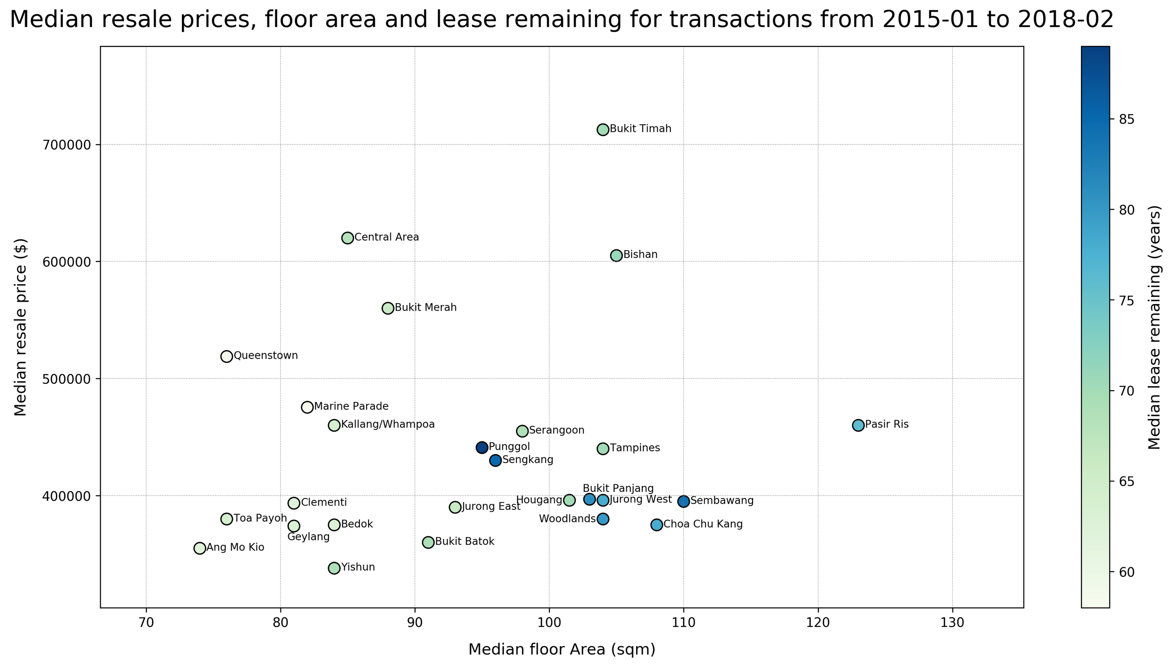
Towns with median lease remaining of 80 years or more tended to have relatively lower median resale prices
resale FLAT TRANSACTIONS
Notes:
In terms of typical prices and median attributes, resale transactions involving new flats tend to be lower in price
The best bang-for-buck flats could possibly be found at the darker blue markers in the lower right quadrant – Sembawang, CCK, Pasir ris, Jurong West, Bukit Panjang and Woodlands
https://stackedhomes.com/hdb-estates.html
http://www.hdb.gov.sg/cs/infoweb/about-us/history/hdb-towns-your-home

Slide 18
Median resale prices in non-mature towns tend to be lower.
There is more variability in the median lease remaining in non-mature towns compared to mature towns
Non-mature towns *
resale FLAT TRANSACTIONS
* Source : https://stackedhomes.com/hdb-estates.html
Notes:
Non-mature towns tend to be more affordable than mature towns regardless of lease remaining. They also span a smaller range for median floor area. More uniformity in newer estates.

Slide 19
61% of AMK’s resale transactions were for 2 and 3 room flats, compared to 27% overall
North-east region
resale FLAT TRANSACTIONS
Notes:
Highlighting northeast region towns as a point of interest
Ang Mo Kio seems to have very small flat sizes! Probably very old estate, mostly 1-3room flats being transacted (60.6% of AMK transactions)
Number of resale transactions by flat-type in Ang Mo Kio: 1 ROOM: 0 2 ROOM: 63 3 ROOM: 1685 4 ROOM: 737 5 ROOM: 365 EXECUTIVE: 33 MULTI-GENERATION: 0 Total: 2883
Number of resale transactions by flat-type in Serangoon: 1 ROOM: 0 2 ROOM: 7 3 ROOM: 321 4 ROOM: 594 5 ROOM: 211 EXECUTIVE: 181 MULTI-GENERATION: 0 Total: 1314
OVERALL, % of resale transactions for 1-3 room is 27%

Slide 20
Central Region
Flats in the Central Region tended to have higher median resale prices.
TPY and Geylang’s median resale prices are lower compared to their counterparts in the Central region
resale FLAT TRANSACTIONS
Notes:
CENTRAL Region tends to have higher prices and wide spread of floow values
Toa Payoh Number of resale transactions by flat-type : 1 ROOM: 0.0% 2 ROOM: 1.0% 3 ROOM: 26.1% 4 ROOM: 41.2% 5 ROOM: 23.8% EXECUTIVE: 7.8% MULTI-GENERATION: 0.0% Total: 59809
ABOUT 50% of toa payoh/GEYLANG is 1-3 room
GEYLANG Number of resale transactions by flat-type in Geylang: 1 ROOM: 0.0% 2 ROOM: 3.9% 3 ROOM: 46.8% 4 ROOM: 33.3% 5 ROOM: 12.5% EXECUTIVE: 3.4% MULTI-GENERATION: 0.0% Total: 1650

Slide 21
For Pasir Ris, 58% of resale transactions were for 5 room flats and above, compared to 31% overall
resale FLAT TRANSACTIONS
Notes:
Pasir Ris resale transactions were mostly for 5 room flats and above
Compare this with the overal distribution,
4 ROOM: 41.2% 5 ROOM and above: 31% !!

Slide 22
SUMMARY
Resale transaction prices generally showed a right-skewed distribution
91% of resale transactions in the period were for 3-room to 5-room flats. These flat types also had a wider spread of resale prices with many outliers
The highest resale price transactions for each town tend to be clustered together in the scatter plot, with resale prices ranging from $800,000 to $1,200,000 and floor area between 100 - 200sqm.
Median resale prices in non-mature towns tend to be lower. There was also more variability in the median lease remaining compared to mature towns
Flats in the central region tended to have higher median resale prices.
resale FLAT TRANSACTIONS

Slide 23
Singapore Resident Population in HDB Flats

Slide 24
ABOUT THE DATA SET
Gives a breakdown of number of Singapore Citizens and Permanent Residents living in sold and rental HDB flats, in each town, from Financial Year 2008 – 2016
243 Records with 3 variables – financial year (‘year’), town (‘town’) and population (‘population’)
‘year’ covers years from 2008 – 2016
‘town’ covers 26 unique towns, and a “Total” value, which sums the HDB Singapore resident population over all towns for that given year
Population gives the absolute number of residents for the given ‘year’ and ‘town’
Resident Population in HDB Flats

Slide 25
PROCESS
Data was loaded into array using np.genfromtext with variable names ‘year’, ‘town’ and ‘population’
Functions such as len, min(), max(), np.unique used to get info about size of data set and range of data values
To visualize overall HDB population trend from 2008 – 2016, line chart was used as it can clearly show how numerical values vary over time.
plt.plot for line chart
plt.text and bbox specifications for text label showing % change at 2016 compared to 2008
Resident Population in HDB Flats

Slide 26
PROCESS
To compare 2016 population and % change in population in different towns, bar charts would best illustrate numerical differences between different towns.
For chart readability, data was ordered by values of interest, in ascending order.
merge_arrays from numpy.lib.recfunctions to transform data into new structured array of columns containing variables ‘town’, ‘startpop’ (population at 2008), ‘endpop’ (population at 2016), ‘change’ (% change in population comparing 2016 and 2008)
plt.bar for bar charts, array indexing to achieve color-coded bars
plt.axvline to draw vertical reference lines
plt.grid to include gridlines on chart
Resident Population in HDB Flats

Slide 27
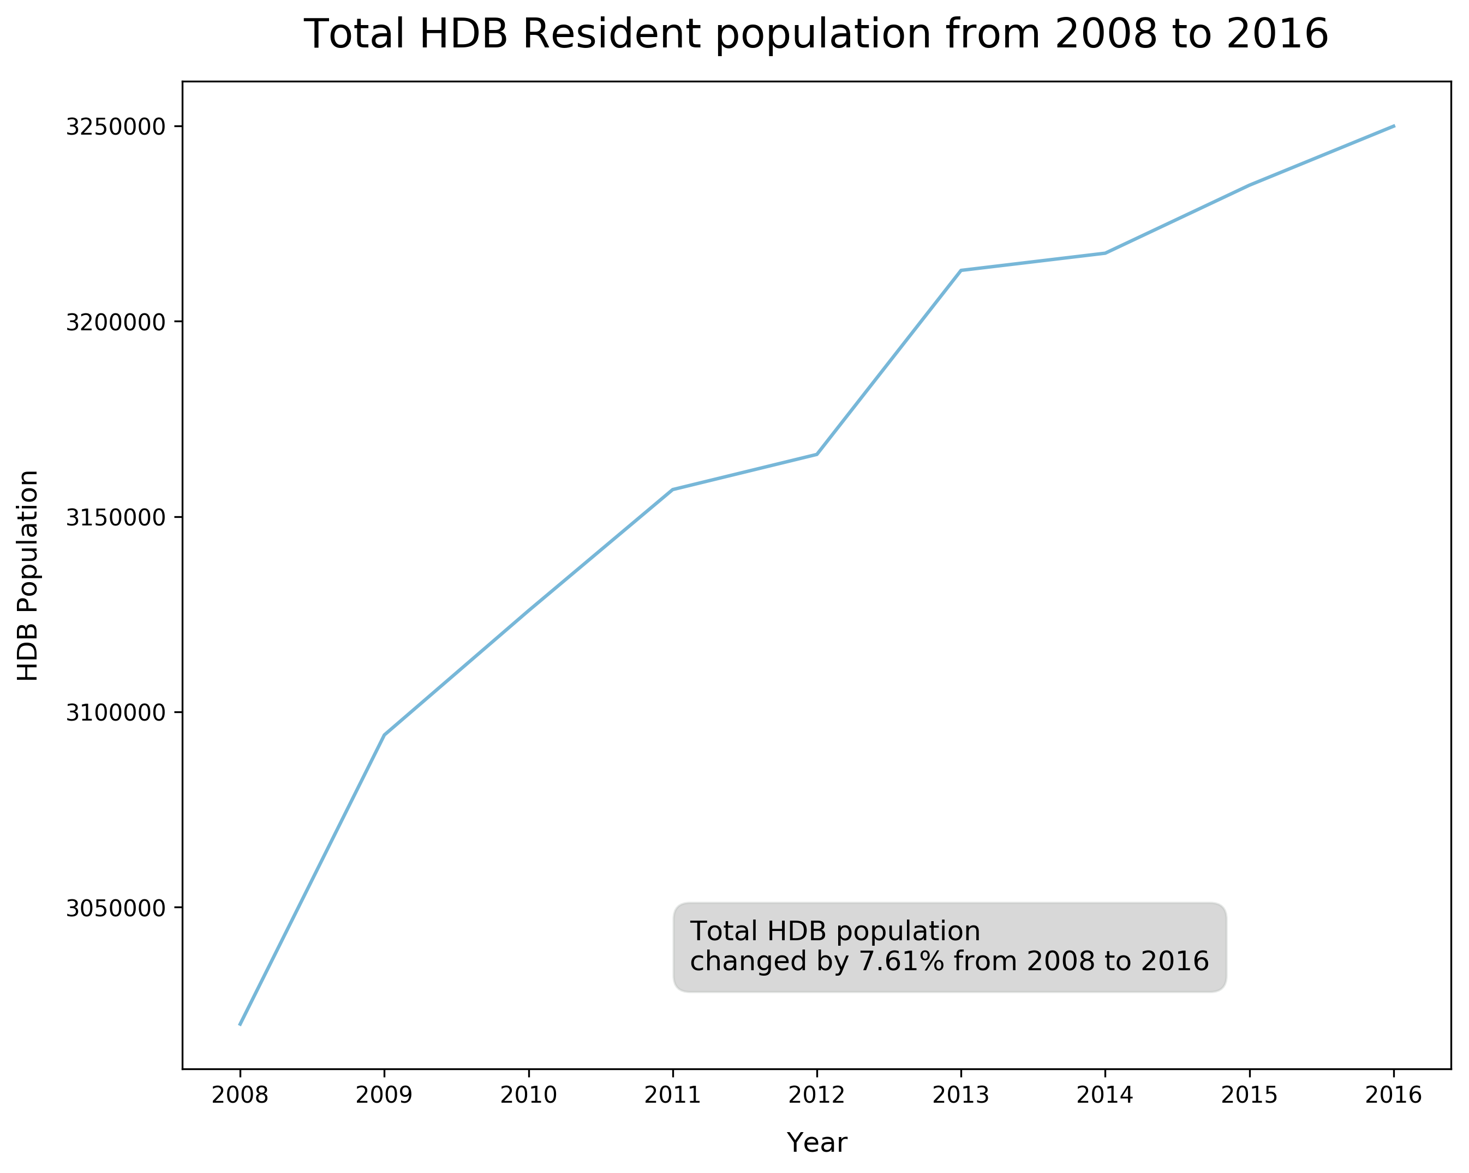
Overall, HDB population showed an increase from 3,020,100 in 2008 to 3,249,900 in 2016, an increase of 7.61%
Resident Population in HDB Flats

Slide 28
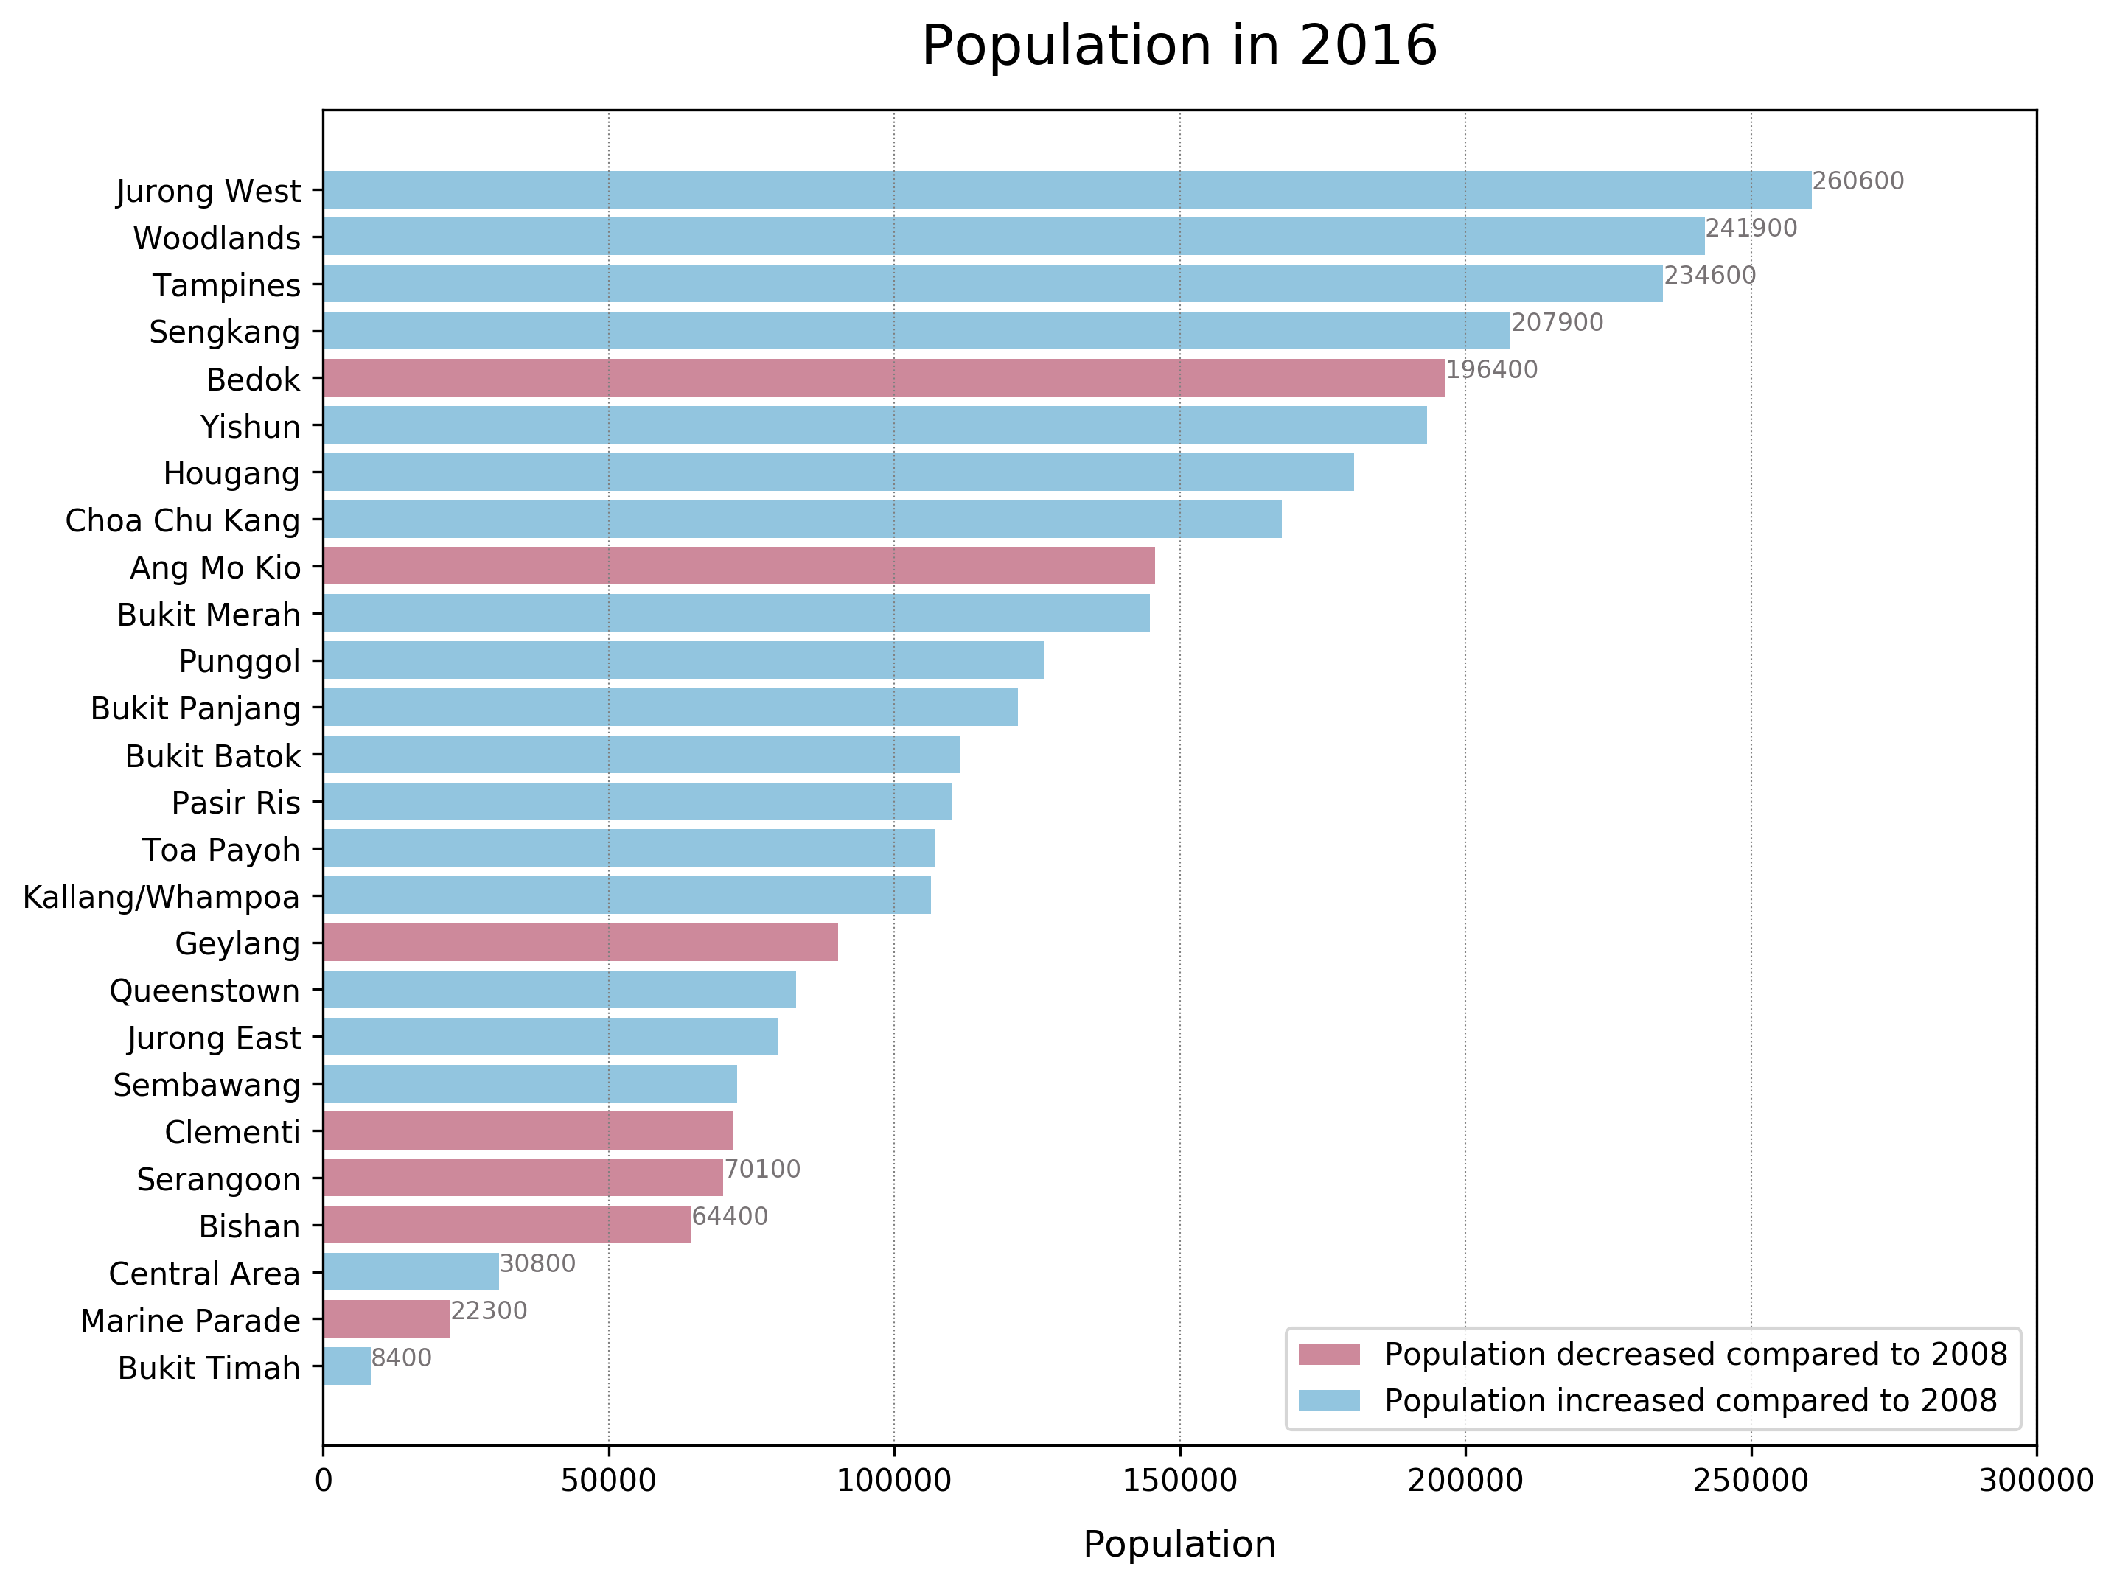
Largest town populations were in Jurong East, Woodlands, Tampines, Sengkang & Bedok
Resident Population in HDB Flats

Slide 29
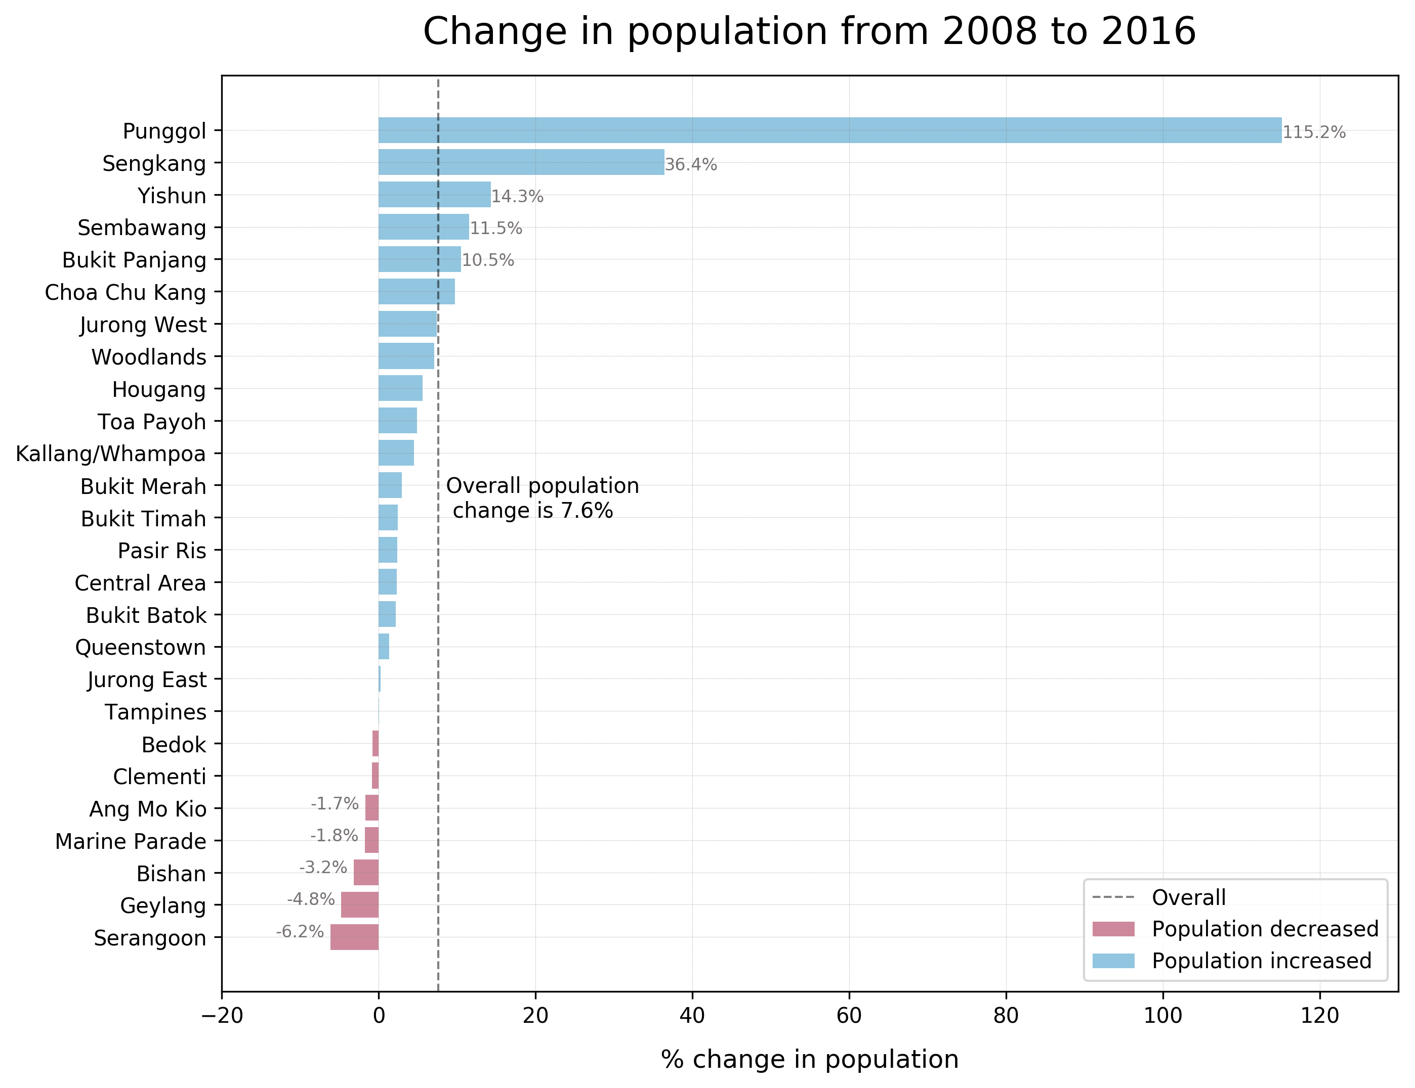
Non-mature towns*
Punggol & Sengkang by far the fastest growing towns.
Non-mature estates tended to have larger population increases, with the exception of Bukit Batok and Jurong East
* Source : https://stackedhomes.com/hdb-estates.html
Resident Population in HDB Flats
Notes:
Growth in most towns hover around -6% to 14%; Punggol and Sengkang are by far the fastest growing towns at 36% and 115% respectively
Town populations are declining fastest in mature estates : Serangoon and Geylang
Non – mature towns have the fastest growing populations, except BB and JE

Slide 30
SUMMARY
Overall, HDB population increased by 7.6% from 2008 – 2016
Largest populations were in Jurong West, Woodlands, Tampines, Sengkang and Bedok
Of these towns, only Sengkang is growing faster than the overall rate, while Bedok’s population is declining slightly
Growth in most towns hover around -6% to 14%; Punggol and Sengkang are by far the fastest growing towns at 36% and 115% respectively
Town populations are declining fastest in Serangoon and Geylang
Non-mature estates tended to have larger population increases, with the exception of Bukit Batok and Jurong East.
Resident Population in HDB Flats

Slide 31
Age group distribution in hdb flats

Slide 32
ABOUT THE DATA SET
Data is from the Sample Household Survey conducted every 5 years
There are a few data sets at the URL. For the purpose of analysis, the data set ‘Age of HDB Resident Population by flat type’ was used
The data set has 42 records with 4 different variables: survey year (‘year’), flat type (‘type’), age group (‘age_group’) and percentage (‘percentage’)
‘year’ covers 2008 and 2013
‘age_group’ covers 3 age groups : '15 - 64' , '65 & above' , 'Below 15’
‘type’ covers 6 flat types: 1 - room to 5 - room and Executive. There’s also an ‘All’ value which corresponds to overall age distribution across all flat types
‘percentage’ gives the percentage of residents in that age group for that particular flat type
Age group distribution in HDB Flats
Notes:
The data set has 42 records It covers 2 years: 2008 and 2013 There are 7 flat types: ['1-room' '2-room' '3-room' '4-room' '5-room' 'All' 'Executive'] There are 3 age groups: ['15-64' '65 & above' 'Below 15']

Slide 33
PROCESS
Data was loaded into numpy array using np.genfromtext with variable names ‘year’, ‘type’, ‘age_group’ and ‘percentage’.
A pie chart was used to compare overall age distribution between 2008 and 2013
plt.pie for pie chart
matplotlib.gridspec to control layout of pie charts
For comparing age distribution in different flat types in 2013, bar charts were used.
plt.bar for bar charts
array indexing and specifying bar width to control x positions to plot grouped vertical bars for each flat type
Age group distribution in HDB Flats

Slide 34
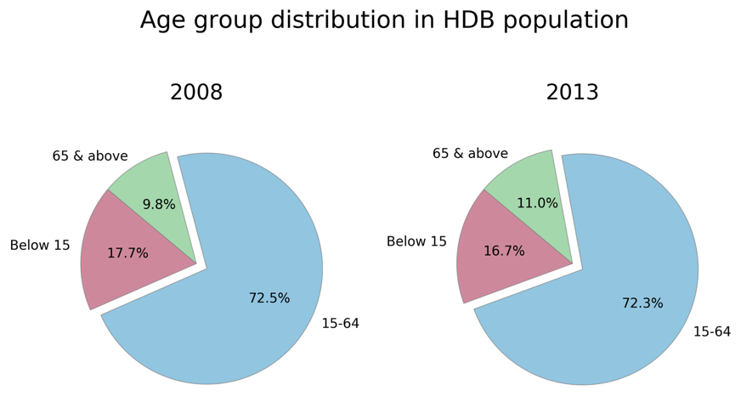
Percentage of HDB residents aged > = 65 years increased by 1.2% and percentage of residents aged <15 years decreased by a comparable amount (-1.0%)
Age group distribution in HDB Flats
Notes:
From 2008 – 2013, percentage of age group > 65 years increased by 1.2% and percentage of age group <15 years decreased by a comparable amount (-1.0%)
This is in line with Singapore’s trend of an aging population, given that the majority of Singapore residents stay in HDB flats. The percentage however is small, and further study is required ascertain if this observation is caused by other factors.

Slide 35
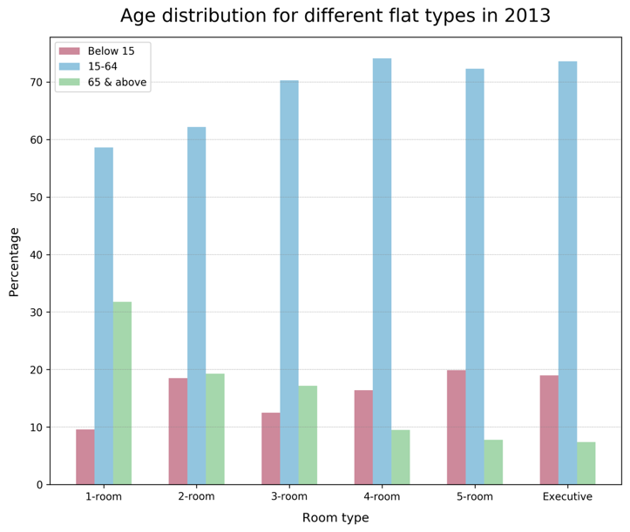
1 room flats tend to have larger proportion of residents aged >= 65 years (31%) and smaller proportion of residents aged <15 years (~10%).
Larger flats tend to have larger proportion of residents in the age group 15 – 64 years.
Age group distribution in HDB Flats
Notes:
Comparing flat types in 2013, 1 room flats have the highest proportion of >65 years and lowest proportion of <15 years. This is unsurprising as seniors may tend to downgrade when they retire and their children move out. Children < 15 years would most likely be staying with their families, so are less likely to stay in a 1 room flat and therefore make up a comparatively small fraction in 1 room flats
larger flats have more economically active adults (more able to afford large flats?)
Surprisingly, this trend is not seen in 2 – room flats, where almost 20% of residents are < 15 years, comparable to 5-room/Executive
As expected, the larger flats (4-room to Exec) have a higher proportion of age group 15 – 65 , the age-group that is most likely to be economically active, and therefore able to afford larger flats

Slide 36
SUMMARY
From 2008 – 2013, percentage of HDB residents aged >= 65 years increased by 1.2% and percentage of residents aged <15 years decreased by a comparable amount (-1.0%)
For 2013, 1 - room flats tended to have larger proportion of residents aged >= 65 years (31%) and smaller proportion of residents aged <15 years (~10%).
Larger flats tend to have larger proportion of residents in the age group 15 – 64 years.
Age group distribution in HDB Flats

Slide 37
FURTHER EXPLORATION
Investigate how median resale price has varied with time on quarterly basis
Incorporate all resale flat transactions for analysis
Compare resale data in 2016 with population / population change in 2016 to see if there is any correlation
Compare resale trends between different towns or different regions by using individual plots for each town -> comparing median values does not give the entire picture!

Slide 38
THANK YOU!

